Slide 1



Traffic prediction in machine learning
By Nupriya Saxena (STB03) Under the guidance of Urooj Khan
Submitted to Meta Scifor Technology

Slide 2

Content
Introduction of problem statement
Data collection
Data cleaning
Data preparing
Data visualization
Data training
Model creation
Model evaluation
Parameter tuning
Prediction

Slide 3

Methodology
Decision tree regression
Linear regression
Random forest regression
XGB regression
Grid search CV

Slide 4

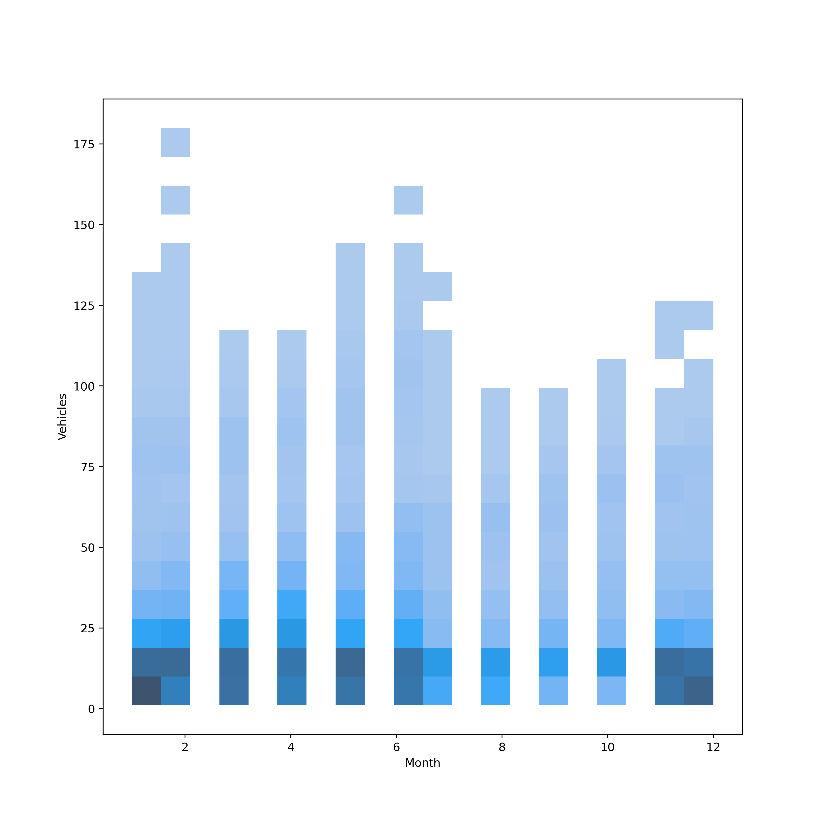
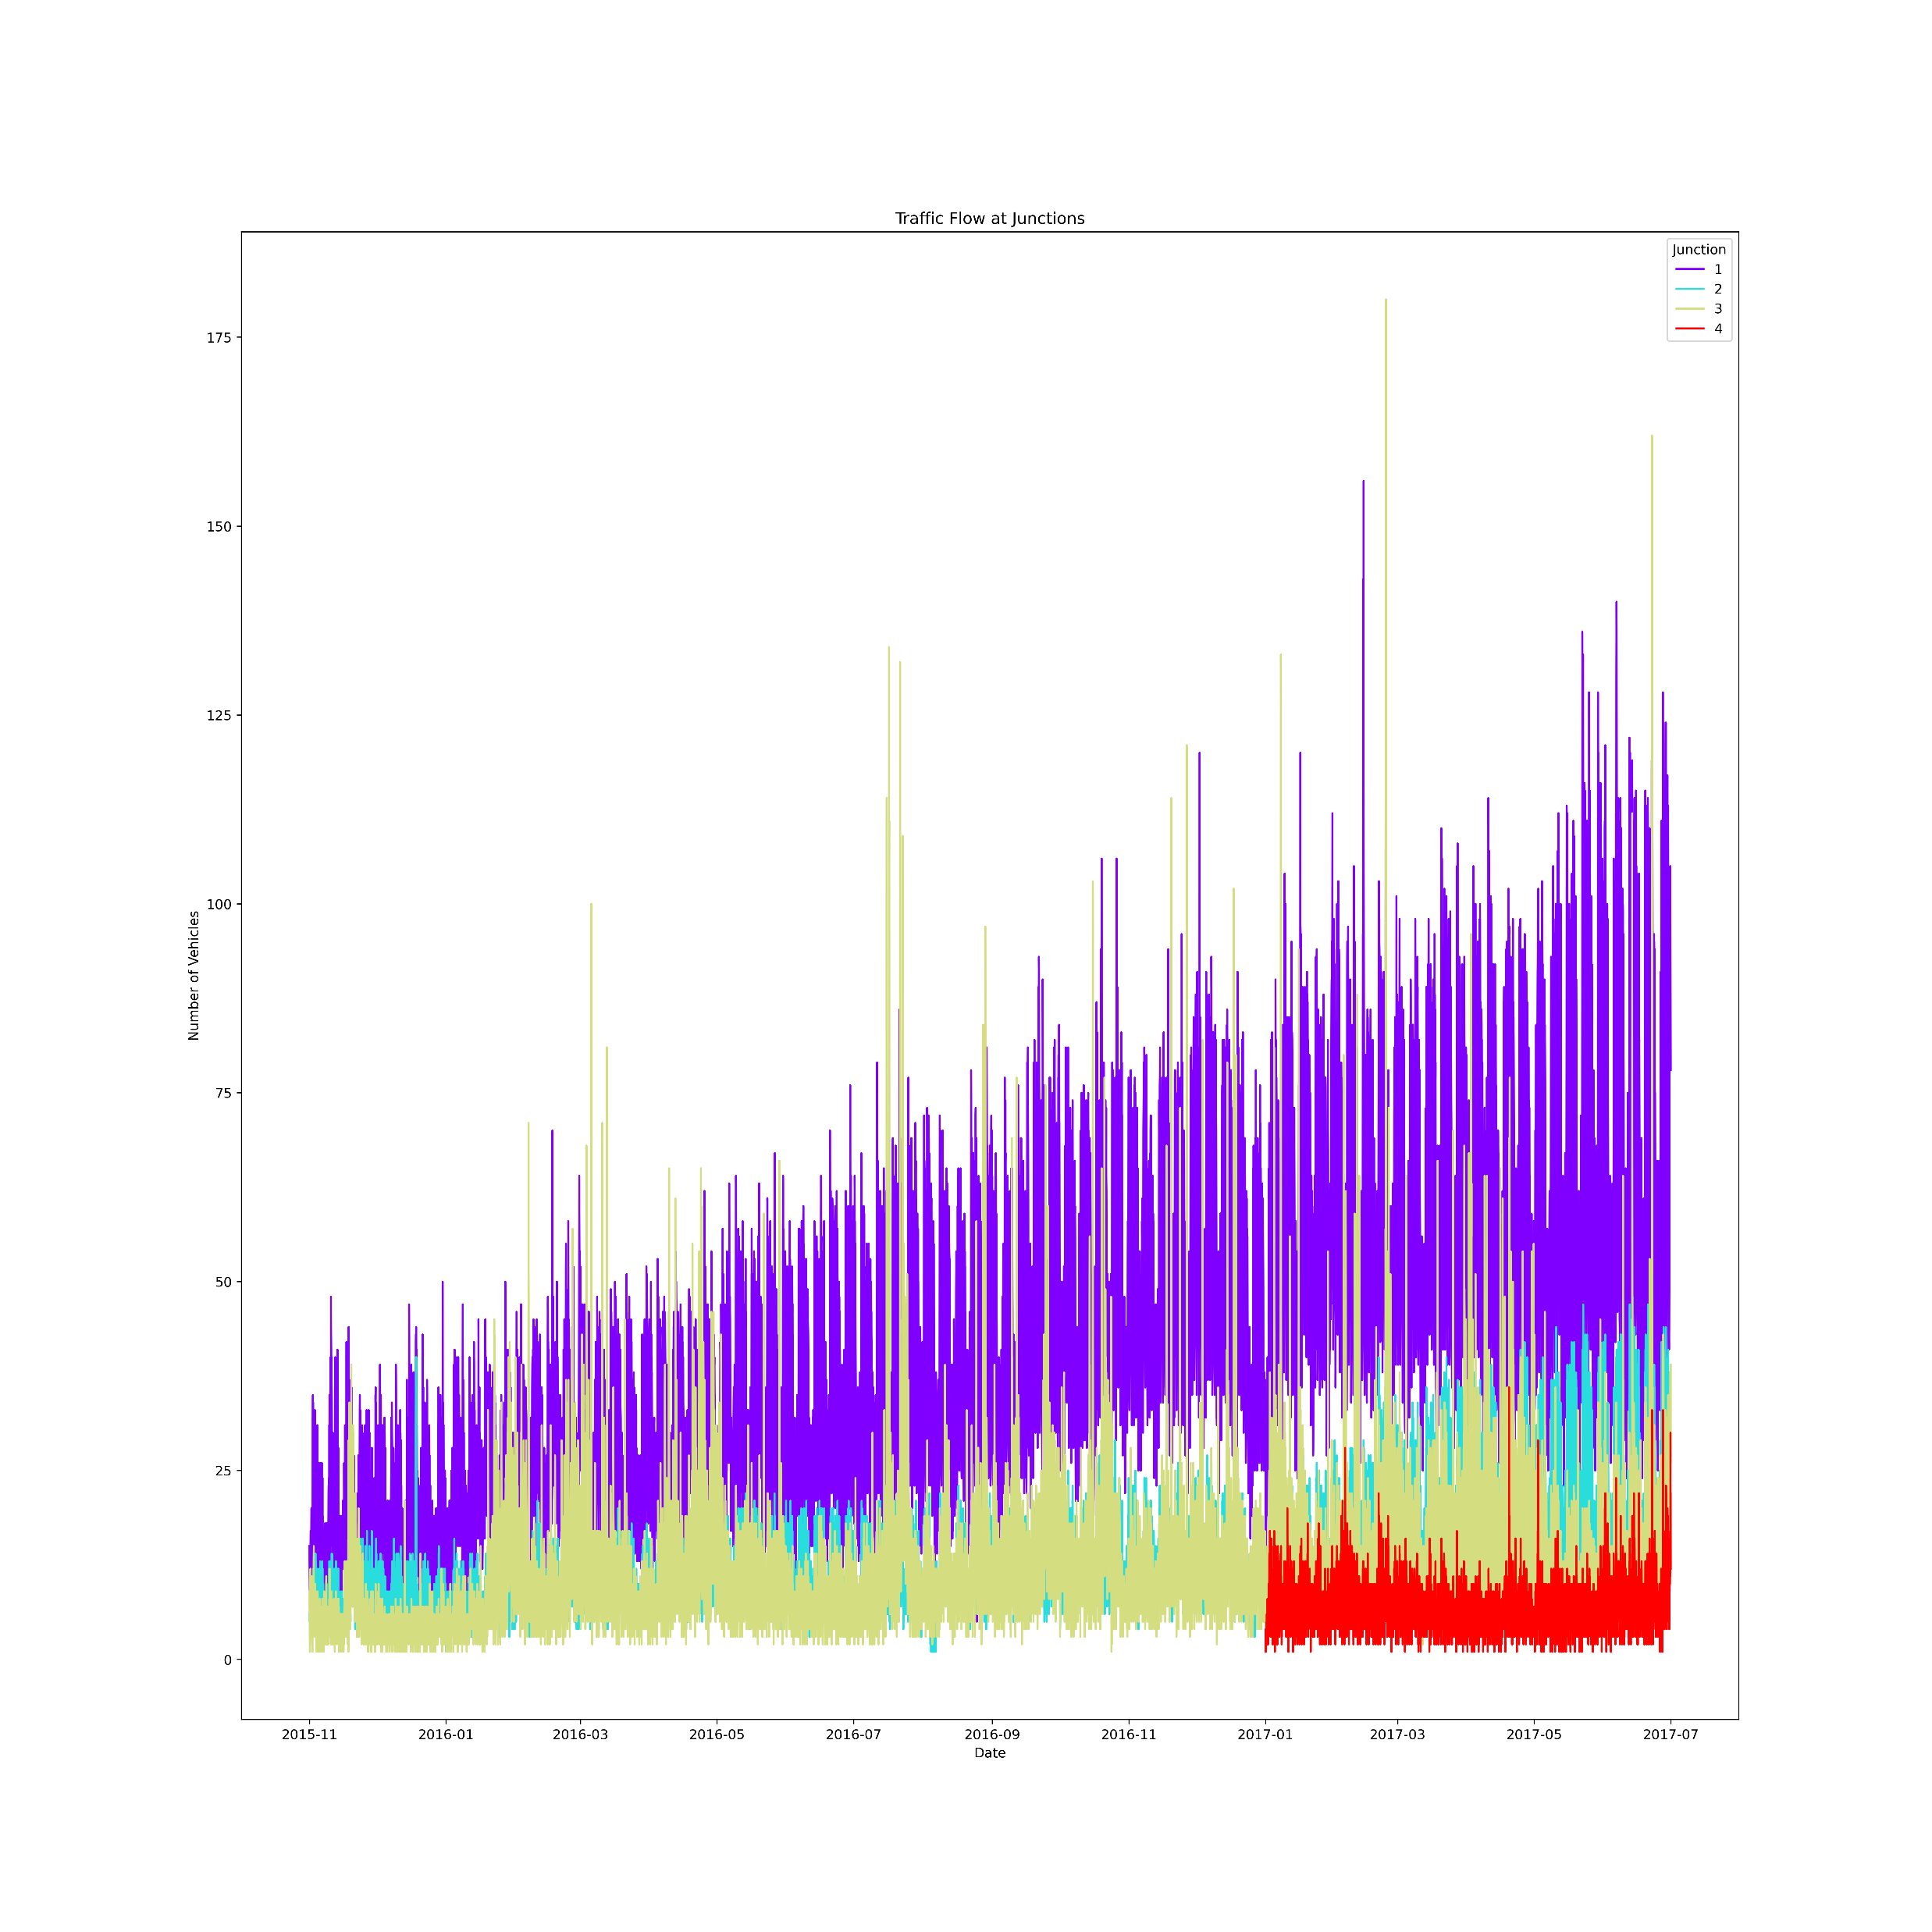
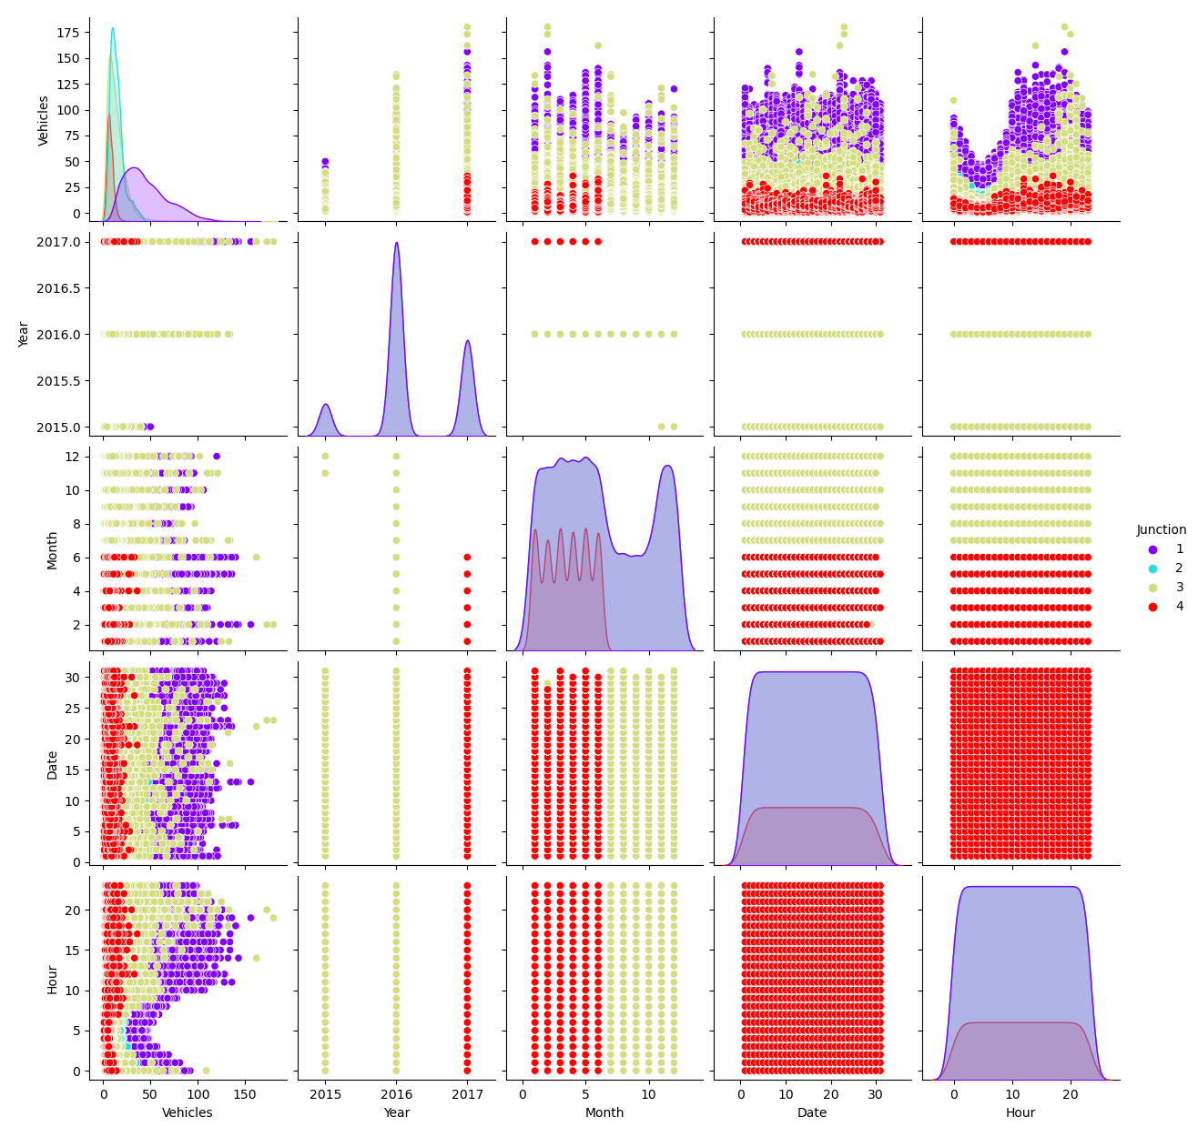
Data visualization

Slide 5

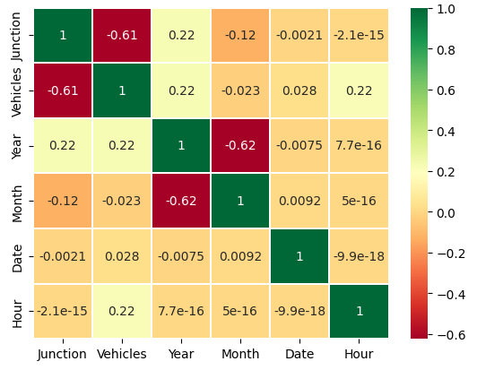
Heatmap to show correlation

Slide 6

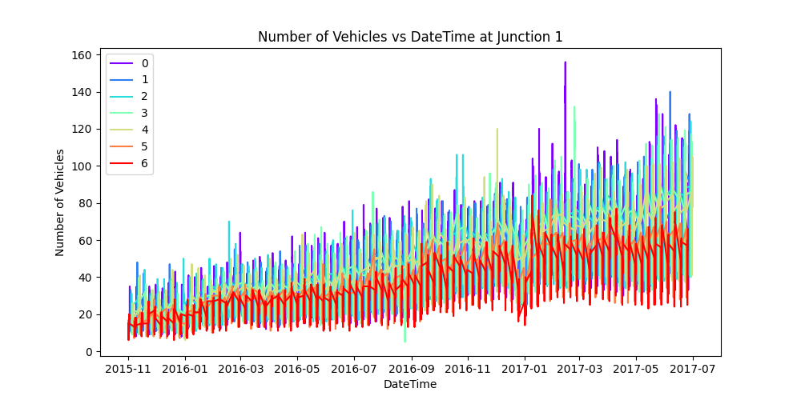
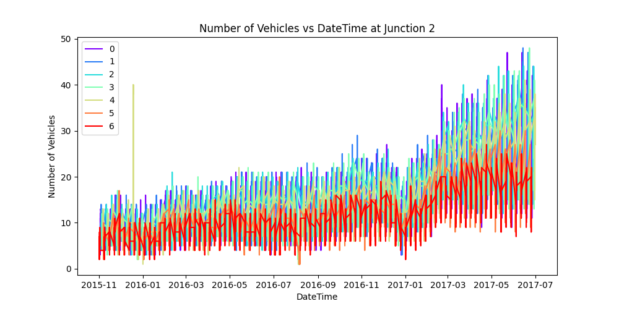
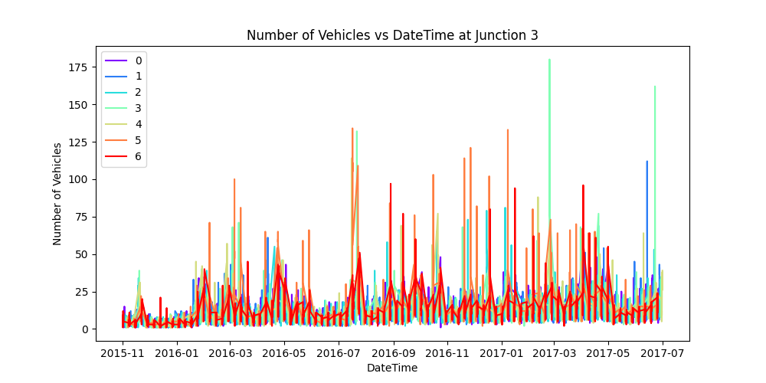
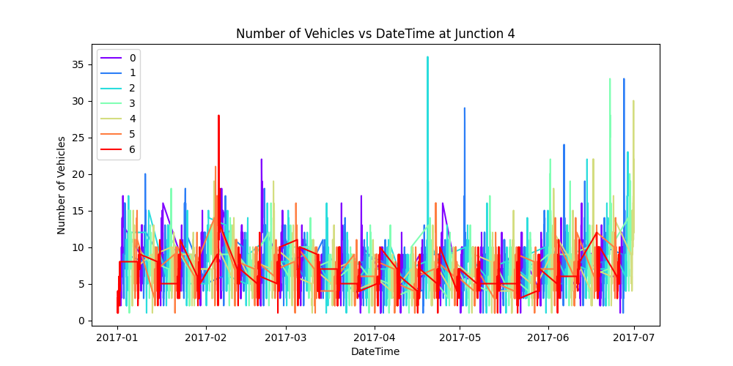
Divide of data in junction wise

Slide 7

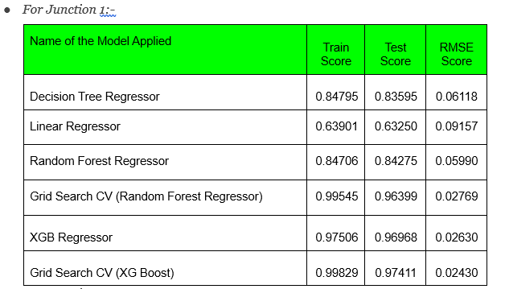
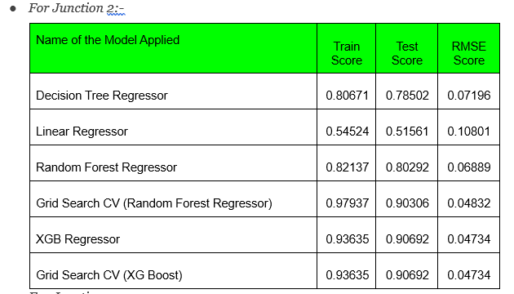
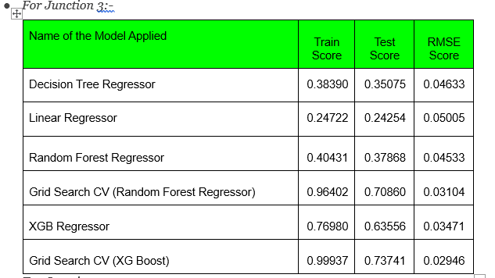
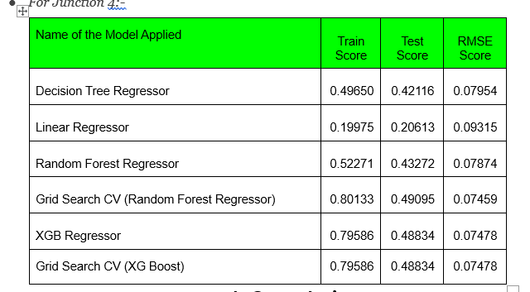
Evaluation of model

Slide 8

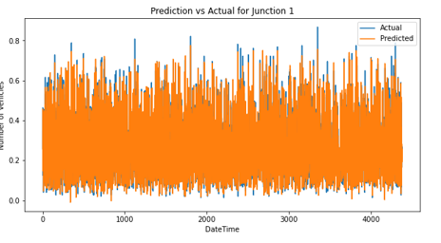
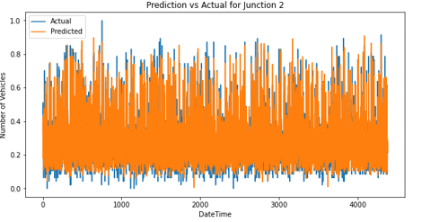
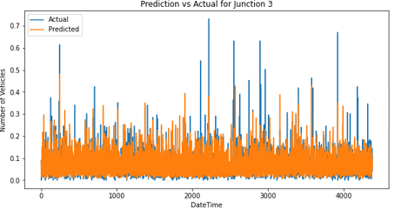
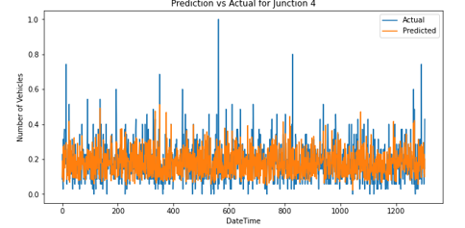
Results and Analysis

Slide 9

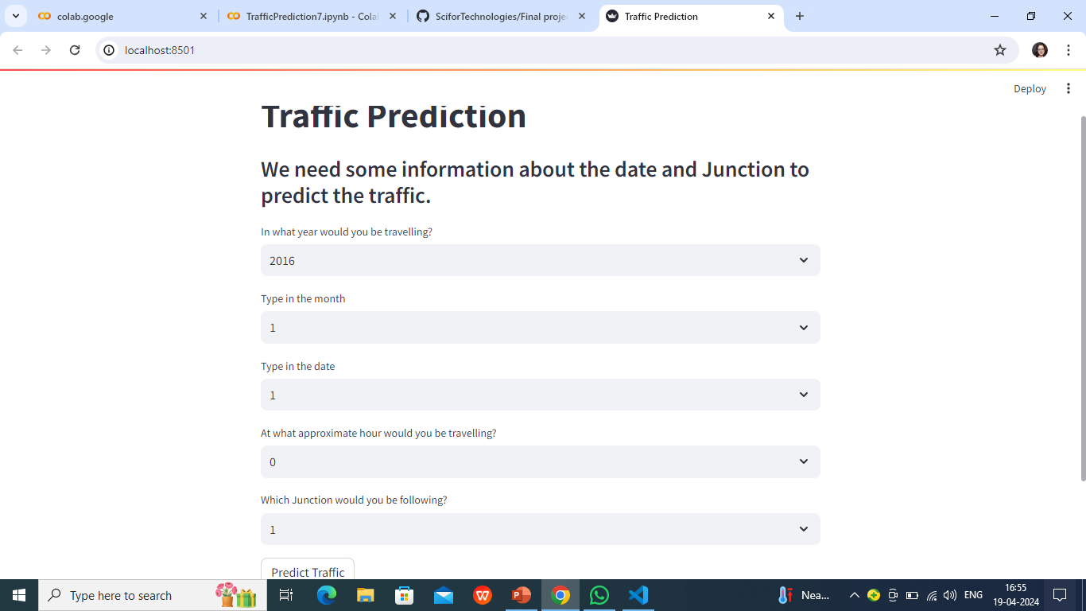
Web Application

Slide 10

Thank you

